Slide 1
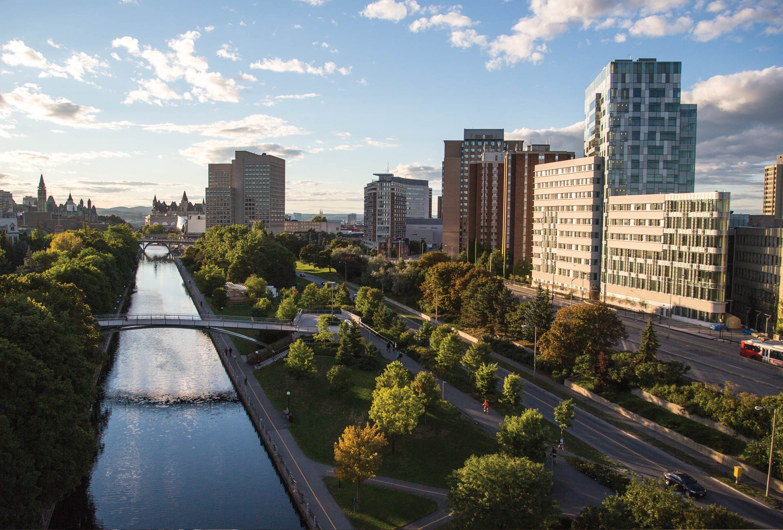

Experiential Indigenous Health Education in Undergraduate Medicine:
Insights From Learners and Facilitators of the Blanket Exercise
Noah Bennell, Lyric Oblin-Moses, Hannah McKay, Mia Otten, Dr. Darlene Kitty, Dr. Alex Petiquan, Dr. Amy Nakajima, Dr. Laura Muldoon, Dr. Brad MacCosham, Luc Brisebois, Meghan Cornett, KJ Chen
Faculty of Medicine, University of Ottawa
Indigenous Medical Learners Association
April 19, 2026
Notes:
Hello everyone. My name is Noah. I’m a second-year medical student at the University of Ottawa and a member of the Northwest Territory Métis Nation.
Today, I am presenting an evaluation of the Blanket Exercise as a formal experiential learning tool within an undergraduate medical school curriculum.

Slide 2
Background: Blanket Exercise
Interactive Learning: Explores historical and contemporary relations on Turtle Island.
Experiential Model: Moves beyond passive "content delivery" toward physical and emotional engagement.
Primary Goal: To foster a deeper, lived awareness of Indigenous realities that traditional lectures cannot replicate.
Notes:
The Blanket Exercise is fundamentally built on interactive learning, mapping out over five centuries of historical and contemporary relations on Turtle Island. It uses an experiential model that moves beyond passive 'content delivery' by requiring both physical and emotional engagement.
Ultimately, the goal of the exercise is to foster a deeper, lived awareness of Indigenous realities.

Slide 3
Background: The Gap
Existing Literature: Most research focuses on other sectors; medical education application is under-researched.
Building on Herzog et al. (2021): While a previous study from UofT proved the effectiveness of the exercise in fostering "critical consciousness," our program evaluation addresses three implementation gaps:
  The Bilingual Context
  Facilitator Perspectives
  Operational Optimization
Notes:
Most existing research on the Blanket Exercise focuses on other sectors, leaving its application in medical education under-researched. We’re building on the 2021 study by Herzog and colleagues at U of T, which successfully demonstrated the exercise's power to foster 'critical consciousness' in students.
Our evaluation takes this a step further by addressing three key implementation gaps: the bilingual context of our institution, facilitator perspectives, and the operational optimizations required to scale this effectively for a large medical cohort."

Slide 4
Methods: Indigenous Curriculum Working Group
Indigenous Curriculum Working Group: Multi-disciplinary team of students, faculty, and staff to enhance Indigenous curriculum.
Overarching Frameworks:
  Participatory Action Research
  Two-Eyed Seeing
Notes:
The planning and implementation of the Blanket Exercise was carried out by the Indigenous Curriculum Working Group and members of the Blanket Exercise team. Lyric and I both discussed the details of the working group in our previous talks, so I’ll be brief. The working group is a multi-disciplinary team of Indigenous students, residents, and physicians, and non-Indigenous faculty and staff. The working group was developed by the students in an effort to enhance the University’s Indigenous health curriculum.
We grounded our work in Participatory Action Research (PAR), ensuring that those most impacted by the curriculum—the learners—led the reform with the support of faculty. We also used a Two-Eyed seeing approach, ensuring Indigenous values and perspectives were incorporated throughout the entirety of our work alongside institutional guidelines and policies.

Slide 5
Methods: Mapping and Gap Analysis
Mapped our curriculum against three national standards.
  Truth and Reconciliation Calls to Action
  Medical Council of Canada Objectives
  CACMS Accreditation Standards
Gaps in lessons on Indigenous history and experiential learning activities.
Notes:
As part of our working group’s project, we conducted mapping of our curriculum and a gap analysis using three national standards. I discussed this in more detail in my talk on Friday. From this mapping, we identified gaps in lessons on Indigenous history and experiential learning activities, among other things.

Slide 6
Methods: Partnership
Blanket Exercise identified as a learning tool to bridge these gaps.
Engaged with a local Elder who helped build a facilitation team.
Over the course of several meetings and sharing circles, outlined our plan.
Notes:
The Blanket Exercise was identified by the working group as a learning tool to bridge these gaps. We identified learning objectives and MCC objectives that would fit well with the exercise. We then sought out guidance from a local Elder who was familiar with the exercise and has run it many times before in a variety of settings, including medical. She connected us with other facilitators in the Ottawa region and we were able to build a team. Over the course of several meetings and sharing circles we outlined our plan.

Slide 7
Methods: The Blanket Exercise
Pre-session meeting for Indigenous students to address their involvement in the exercise.
First-year students divided into three groups (English and French streams).
Each group guided by at least one Elder and two facilitators.
A physical demonstration of Indigenous history on blankets representing 'Turtle Island’.
  Students physically removed from blankets to represent land loss and colonial policy impacts.
Concluded with Elder storytelling and facilitated sharing circles for reflection.
Notes:
Teaching Indigenous history requires a constant awareness of potential re-traumatization. To address this, we held a proactive sharing circle for first-year Indigenous students and the second-year students assisting with the session. This allowed us to set expectations and ensure everyone felt safe and comfortable and knew who they could go to for support; ultimately, all Indigenous students consented to take part.
The exercise took place late September to align with National Day for Truth and Reconciliation. Before the exercise, the Director of our Indigenous Program gave a brief overview of the exercise to all students. We then split the cohort into three groups—two English and one French— , each guided by at least one Elder and two facilitators.
The Blanket Exercise is a physical demonstration of history: blankets are placed on the floor to represent the land, and participants stand on them as a script moves from pre-contact to the present.
As the narrative progresses, blankets are removed to symbolize land loss, and participants are relocated or removed to represent the impacts of residential schools and forced relocation. We concluded the session with an Elder sharing their lived experiences, followed by a sharing circle for collective reflection.

Slide 8
Methods: Design & Analysis
Approach: Mixed-methods evaluation involving 145 students and 12 facilitators.
Data Collection: Anonymous Likert-scale surveys and open-ended reflections.
Indigenous Methodology: Facilitator surveys supplemented by in-person sharing circle.
Core Domains:
  Curricular alignment and historical knowledge.
  Indigenous resilience and personal bias reflection.
Analysis: Descriptive statistics and NVivo thematic coding.
Notes:
Our evaluation of this intervention involved a mixed-methods approach involving 145 students and 12 facilitators.
Following the exercise, students completed an anonymous questionnaire utilizing a 5-point Likert scale and open-ended responses. We assessed several key domains:
Alignment with curricular learning objectives.
Knowledge of Indigenous history and the impact of colonialism on health.
Recognition of Indigenous resilience.
Reflection on personal biases and the importance of culturally competent care.
Facilitators were also surveyed on the pedagogical appropriateness of the exercise. To honour Indigenous ways of knowing, we supplemented these surveys with an in-person oral debrief, allowing facilitators to share their perspectives through verbal storytelling.
Quantitative data were analyzed using descriptive statistics across both language streams. For the qualitative data, I used NVivo to conduct a thematic analysis. I developed a structured codebook through both inductive and deductive coding, ensuring the findings reflected both our pre-defined curricular goals and the emergent sentiments of the participants.

Slide 9
Results: Students Survey Responses
Notes:
Data across both English and French streams show consistent alignment. Key highlights include:
Curricular Alignment: High agreement that the session met its learning objectives.
Knowledge Acquisition: Self-reported gains in understanding Indigenous history, the ongoing impacts of colonialism, and the importance of resilience.
Professional Growth: Students noted the exercise effectively encouraged reflection on personal biases and the necessity of culturally competent care.

Slide 10
Results: Student Themes
Experiential Learning
History and Ongoing Legacy of Colonialism
Application to Medicine
Learning Environment
Notes:
Experiential Learning: Students found the participatory, visual and physical nature of the activity significantly more impactful than traditional lecture-based learning.
Historical and Ongoing Legacy of Colonialism: Participants successfully linked events and policies—such as the Indian Act—to modern systemic barriers within the healthcare system.
Application to Medicine: Learners explicitly connected the exercise to their future clinical roles, focusing on bedside manner, advocacy, and the social determinants of health.
Finally, the Learning Environment was a key finding. Our data showed that a safe, respectful, and reflective space is absolutely mandatory for students to process the emotional weight of this history. Participants noted that hearing from Elders and their peers was a major highlight; helped challenge and grow their own perpsectives. And specifically, hearing from their Indigenous classmates.

Slide 11
Results: Facilitators Survey Responses
Notes:
Facilitator feedback mirrored these positive sentiments:
Appropriateness: 100% agreement that the Blanket Exercise is a suitable and effective tool for medical learners.
Awareness: Near-universal consensus that the exercise successfully enhanced awareness of lived realities and systemic inequities.

Slide 12
Results: Facilitator Themes
Facilitation Style
Navigating Emotional Responses
Environmental Challenges
Pre-session support
Notes:
Facilitation Style: Success was driven by the facilitator’s ability to ground the session in personal storytelling and traditional protocols, such as sharing circles.
Navigating Emotional Responses: Facilitators highlighted the significant emotional labor required to manage intense student reactions and the need for trauma-informed expertise.
Environmental Challenges: Logistics such as noise, inadequate acoustics, and large group sizes (no more than 20-30) were identified as primary barriers to session quality.
Pre-Session Support: Facilitators were clear that success starts well before the blankets are laid down. They highlighted the need for pre-session briefings with faculty and staff to sort out the logistics—like room acoustics and group sizes—and to align on how the BE fits into the medical school’s specific learning expectations. At the same time, supplying students with preparatory materials and supports ensures they are cognitively and emotionally ready.

Slide 13
Discussion
Valid teaching tool for both language streams.
Why so effective?
  Students: Value lies in participation and reflection.
  Facilitators: Incorporating storytelling and navigating emotions.
Looking forward:
  Durability
  Institution-wide implementation
Notes:
"To wrap up our discussion, our results provide clear evidence that the Blanket Exercise is a valid, robust teaching tool for both language streams. We’ve added to the literature by confirming it doesn’t just teach history; it transforms perspectives and allows learners to envisage how this knowledge applies to their clinical practice.
What makes it so effective? From the student perspective, the value lies in the 'doing'—the experiential simulation followed by the time to reflect with Elders and their peers. From the facilitator side, success is driven by their ability to ground the timeline in personal storytelling while navigating the significant emotional weight of the room.
Looking forward, it would be interesting for future research to investigate the durability of these perspective shifts. Specifically, we should look at how long this knowledge and awareness holds as students move into their clinical years and residency. It would also be interesting to use the Blanket Exercise as a teaching tool for faculty and staff to promote cultural knowledge and safety at all levels.

Slide 14
References
Herzog, L. S., Wright, S. R., Pennington, J. J., & Richardson, L. (2021). The KAIROS Blanket Exercise: Engaging Indigenous ways of knowing to foster critical consciousness in medical education. Medical Teacher, 43(12), 1437-1443. https://doi.org/10.1080/0142159X.2021.1923019
KAIROS Canada. (2021). The KAIROS Blanket Exercise (4th ed.). Toronto, ON: KAIROS. (Original work published 1997).
Notes:
"To wrap up our discussion, our results provide clear evidence that the Blanket Exercise is a valid, robust teaching tool for both language streams. We’ve added to the literature by confirming it doesn’t just teach history; it transforms perspectives and allows learners to envisage how this knowledge applies to their clinical practice.
What makes it so effective? From the student perspective, the value lies in the 'doing'—the experiential simulation followed by the time to reflect with Elders and their peers. From the facilitator side, success is driven by their ability to ground the timeline in personal storytelling while navigating the significant emotional weight of the room.
Looking forward, it would be interesting for future research to investigate the durability of these perspective shifts. Specifically, we should look at how long this knowledge and awareness holds as students move into their clinical years and residency. It would also be interesting to use the Blanket Exercise as a teaching tool for faculty and staff to promote cultural knowledge and safety at all levels.

Slide 15
Miigwetch, Thank You, Merci
Notes:
For those of you involved in your school’s curricula, I would highly recommend implementing the Blanket Exercise. Personally, I see it as an invaluable teaching tool and a wonderful first step to teaching students about the history of Indigenous Peoples and preparing them to be culturally competent physicians.

