Slide 1
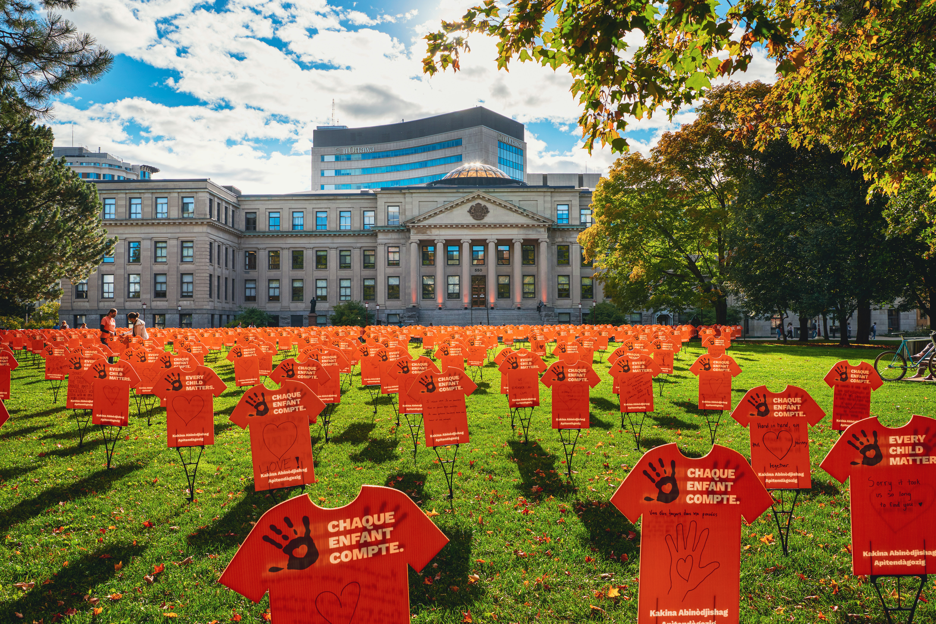

Advancing Indigenous Health and Cultural Safety in Undergraduate Medical Education Through an Indigenous Curriculum Working Group: A Participatory Action Framework​`
April 16, 2026 ICAM
Authors: Lyric Oblin-Moses, Dr. K. J. Chen, Dr. Darlene Kitty, Noah Bennell, Mia Otten, Hannah McKay, Dr. Laura Muldoon, Dr. Alexandre Kokoko Petiquan, Dr. Bradley Mac Cosham, Luc Brisebois, Meghan Cornett, Dr. Amy Nakajima
uOttawa.ca
Notes:
Today, I’ll be sharing our work on advancing Indigenous health and cultural safety in undergraduate medical education through a learner-led and community-engaged curriculum initiative.

Slide 2
Conflicts and Disclosures
This project was funded through a summer studentship at the University of Ottawa

Slide 3
Indigenous Affirmation
We pay respect to the Algonquin people, who are the traditional guardians of this land. We acknowledge their longstanding relationship with this territory, which remains unceded. We pay respect to all Indigenous people in this region, from all nations across Canada, who call Ottawa home. We acknowledge the traditional knowledge keepers, both young and old. And we honour their courageous leaders: past, present, and future.

Slide 4
Outline
Working group team
Background
Methodology
Outcomes
Lessons Learned
Future steps
Notes:
I’ll briefly walk through our background, methodology, key results, lessons learned, and future directions.

Slide 5
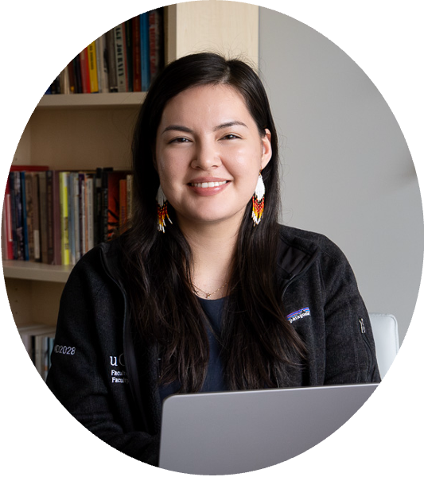
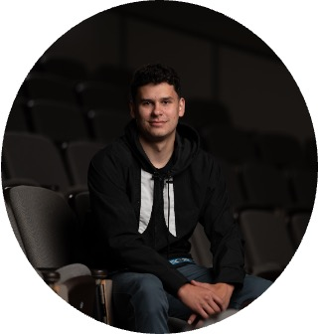

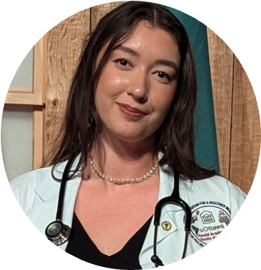
Working Group Team
Student Co-Leads
Lyric Oblin-Moses
Medical Student
Noah Bennell
Medical Student
Mia Otten
Medical Student
Hannah McKay
Medical Student
Notes:
This work was led by Indigenous medical students, supported by an Indigenous resident mentor, faculty leaders across curriculum and Indigenous health, and administrative staff.

Slide 6
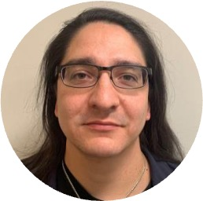
Working Group Team
Indigenous Resident Mentor
Dr. Alexandre Kokoko Petiquan​
Indigenous Mentorship Lead, Undergraduate Medical Education (UGME)

Slide 7
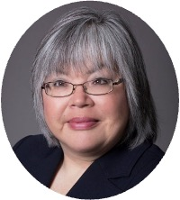
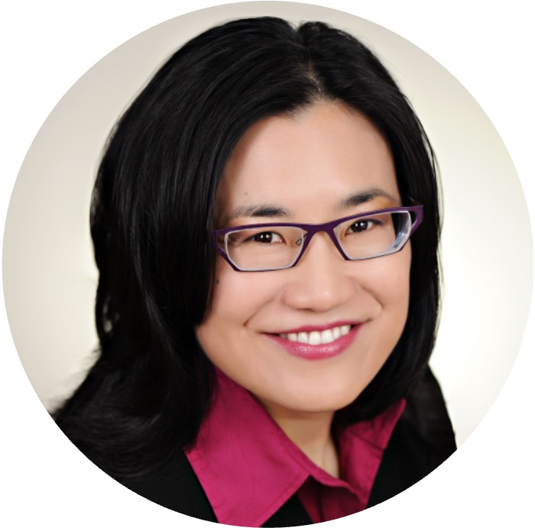
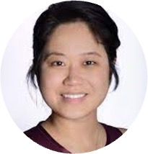
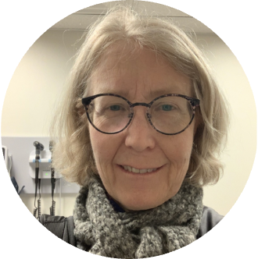
Working Group Team
Faculty Leads
Dr. Darlene Kitty
Indigenous Program Director, UGME
Dr. Amy Nakajima
Pre-Clerkship Director, Anglophone Stream, UGME
Dr. K.J. Chen ​
Assistant Dean, Curriculum, UGME
Dr. Laura Muldoon
Society & Medicine Lead, UGME

Slide 8
Working Group Team
Administrative Supports
Dr. Bradley MacCosham, Accreditation and Program Evaluation, Faculty of Medicine
Luc Brisebois, Indigenous Program, UGME
Meghan Cornett, Academic Delivery Support, UGME

Slide 9
Background
There are three distinct groups of Indigenous Peoples in Canada, First Nations, Inuit, and Métis with unique histories, cultures, languages, and worldviews.
In Canada in 2015, the Truth and Reconciliation Commission (TRC) shared their findings with the country on the harms and ongoing impacts of the residential school system, as well as 94 Calls to Action aimed at advancing reconciliation across sectors, including healthcare and education.
Canadian medical schools called upon to address Indigenous health inequities and advance cultural safety, specifically through Calls to Action 23 and 24. ​
Notes:
In Canada, there are three distinct groups of Indigenous Peoples: First Nations, Inuit, and Métis—each with unique histories and worldviews.
In 2015, the Truth and Reconciliation Commission shared their findings on the harms and ongoing impacts from the residential school system on Indigenous peoples, families, and communities in Canada, and released 94 Calls to Action aimed at advancing reconciliation across various sectors, including health care and education.
Calls to Action 23 and 24 specifically call on professional training programs, including medical schools, to improve Indigenous representation and propose mandatory training in Indigenous health, history, and cultural safety.

Slide 10
Background
Truth and Reconciliation Calls to Action 23 and 24 (TRC, 2015)
Many of the Calls to Action, including 23 and 24, have yet to be fully addressed and implemented. ​
There continues to be an underrepresentation of Indigenous people in health care and leadership roles.​
Gaps persist in Indigenous health and cultural safety education in health professions training programs.
23. We call upon all levels of government to:
  i. Increase the number of Aboriginal professionals working in the health-care field.
  ii. Ensure the retention of Aboriginal health-care providers in Aboriginal communities.
  iii. Provide cultural competency training for all health-care professionals
24. We call upon medical and nursing schools in Canada​ to require all students to take a course dealing with Aboriginal health issues, including the history and legacy of residential schools, the United Nations Declaration on the Rights of Indigenous Peoples, Treaties and Aboriginal rights, and Indigenous teachings and practices. This will require skills-based training in intercultural competency, conflict resolution, human rights, and anti-racism.
Notes:
However, over 10 years after the release of TRC Report, many of the Calls to Action, including 23 and 24, have yet to be fully addressed and implemented. ​
There continues to be an underrepresentation of Indigenous people in health care and leadership roles.​
Gaps persist in Indigenous health and cultural safety education in undergraduate medical education.

Slide 11
Methodology: Participatory Action Framework
Participatory Action Framework is a collaborative approach in which members of community are equal partners in identifying needs and priorities, co-designing solutions, and evaluating processes and outcomes (Baum et al., 2008).
In the context of Indigenous health curriculum development, this means that:
  Respect for Indigenous engagement principles (Kirkness & Barnhardt, 2001)
  Center Indigenous voices and perspectives
  Support and uplift Indigenous learners to engage in curriculum development and advocacy in Indigenous health
Notes:
We utilized a participatory action framework (METHODOLOGY) and the methods were informed by Kern’s 6-Step Framework for Curriculum Development and the Indigenous Physicians Association of Canada (IPAC) Curriculum Implementation Toolkit.
In the context of Indigenous health curriculum development, this meant respecting Indigenous engagement principles, centering Indigenous voices and perspectives, and supporting learners to engage in curriculum development initiatives, advocacy, and leadership in Indigenous health.

Slide 12
Indigenous Engagement Principles
Respect for Indigenous engagement principles (4 R’s) (Kirkness & Barnhardt, 2001)​
Principle | What it meant for us
Respect | Indigenous learners led working group, as well as curriculum development and implementation guided by existing tools developed by Indigenous health leaders and experts
Reciprocity | Summer studentship model ensured Indigenous students were compensated. Relationship-building and mentorship imbedded in the process
Relevance | Curriculum reflect First Nations, Métis, and Inuit realities and experiences
Responsibility | Address TRC Calls to Action; Collaborate with Indigenous Medical Learner’s Association (IMLA) at uOttawa; connect and debrief with Indigenous community members and educators
Notes:
An Indigenous engagement framework we looked to was the 4 R's framework, which outlines ethical engagement with Indigenous communities in a higher education setting. What this meant for us is, respect for lived experiences and knowledge of Indigenous learners, ensuring that mentorship and support was integrated into the process (e.g. Indigenous resident and Faculty mentors), ensuring that the work we did was relevant and reflective of First Nations, Inuit, and Metis realities and experiences, and reflecting and honouring our responsibility, both as individuals and as a collective, to address the TRC calls to action.
As students leading this process, we felt a responsibility to be connected to the Indigenous Medical Learner's Association (IMLA) at uOttawa, which is a larger student body that is independent and ran by Indigenous learners for Indigenous learners, who we've engaged with throughout the process. In fact, the student leads who I shared earlier were nominated by their peers to lead IMLA's Curriculum Pillar to ensure that Indigenous learners voices and perspectives were include in matters related to curriculum.

Slide 13
Methods
Analyze
Design
Develop
Implement
Evaluation
Engagement
Notes:
Here are our outlines steps, not a linear process.

Slide 14
Initiation and Engagement
Indigenous Curriculum Working Group launched May 2025
Identify goals, priorities, and terms of reference
Engagement with learners through a student-led approach
Outreach to community partners
Notes:
The working group met weekly over four months to engage in the steps pertaining to engagement, collaborative visioning and goal-setting, an environmental scan and gaps analysis, curriculum development, implementation, and evaluation

Slide 15
Goals
Building on the direction of the Undergraduate Medical Education Indigenous Program and the Centre for Indigenous Health Research and Education at the University of Ottawa’s Faculty of Medicine, the goals of the Indigenous Health Summer Studentship were:
Respond to Truth and Reconciliation Commission Calls to Action and integrate Indigenous learning goals including Indigenous determinants of health, the history and ongoing legacy of colonialism, and the principles of Indigenous cultural safety, anti-racism, trauma- and violence-informed approaches into medical education​.
Ensure that Indigenous health education is reflective of lived and distinct realities of First Nations, Inuit, and Métis people in the National Capital Region surrounding areas and beyond to better serve and meet the needs of Indigenous Peoples. ​
Ensures that Indigenous health is reflective of lived and distinct realities of First Nations, Inuit, and Métis leaders and community members respecting the principles of Indigenous community engagement.
Notes:
Our goals were to:
Address the TRC Calls to Action
Ensure curriculum reflects First Nations, Inuit, and Métis realities
Engage meaningfully with Indigenous communities

Slide 16
Environmental Scan and Gaps Analysis
Methods
Considered elements such as learning objectives, learning event, format, unit, curricular stream, time, assessment method, mandatory vs non-mandatory.
Curriculum data, evaluations, student perspectives and input from Working Group using a consensus-based approach
Goal: Enhance curriculum alignment with Indigenous health priorities.
Methods: Map content to key frameworks and identify gaps:
Medical Council of Canada (MCC) Indigenous health objectives
Truth and Reconciliation Commission (TRC) Calls to Action
Committee on Accreditation of Canadian Medical Schools (CACMS) national standards
Results
Mapping against MCC Indigenous Health Objectives (Version: April 2025), many of the MCC objectives were either partially addressed or not addressed.
Improvement required to meet TRC Calls to Action and enhance CACMS standards & elements.
Next steps
Build upon existing curriculum to develop a longitudinal Indigenous curriculum in alignment with Indigenous learning goals and engagement principles.
Notes:
To start, we conducted an environmental scan and gaps analysis to better understand what was currently offered in the curriculum and how we could address some of the gaps.
Our gaps analysis found that Indigenous health content was present but fragmented and inconsistently integrated across the curriculum.
Teaching was often didactic, with limited experiential learning, and there was a lack of distinctions-based content across First Nations, Inuit, and Métis perspectives. We also identified gaps in assessment, local relevance, and faculty support.
Overall, this highlighted the need for a more coordinated, longitudinal, and community-engaged approach

Slide 17
Curriculum Development
Identify, adapt, and integrate nationally developed curriculum resources to reflect the needs and realities of local context
Utilizing frameworks such as Kern’s 6-Step Curriculum Development Framework and the Indigenous Physician Association of Canada’s (IPAC) Curriculum Implementation Toolkit
Notes:
In response we identified existing curriculum toolkits developed nationally by Indigenous health experts, and adapted them to align with our learning goals.

Slide 18
Curriculum Implementation (2025-2026)
Experiential learning activity on the history of Indigenous health for 1st year medical students (Anglophone and Francophone)
Enhanced Introduction Unit
  Indigenous Health
  Health Law
Indigenous Health Case Modules
  Interactive small-group case-based discussions
    Cases adapted from nationally developed tools (CFPC, 2024)
    Distinctions-based approach (First Nations, Inuit, and Métis)
    Life-course model
Notes:
The projects we developed and are implementing include an experiential activity for all first-year medical students to teach the history of Indigenous Peoples in Canada, enhancing the introduction unit in first year as well to address topics such as Indigenous health and health law, this is also when students are informed of the experiential activity planned for later in the unit, as well as Indigenous health case modules which were developed for third year medical students to build on what was taught and apply to cases that reflect Indigenous experiences.

Slide 19
Evaluation
Evaluation strategies developed for Indigenous health session.​
Post-session survey (paper and electronic surveys).​
For sessions with Indigenous educators and Elders, we conducted a post-session survey and sharing session to debrief with the purpose of hearing their experiences and how to improve for the future.
Program evaluation data collection ongoing and will be available for 2025-2026 academic year.
Notes:
Evaluation data was collected through a post-session survey which aligns with existing evaluation strategies at the University. We created an Indigenous health specific survey that touched on the Indigenous health learning objectives and some open-ended questions on how we can improve the sessions. We're in the process of collecting and reviewing evaluation data for the learning events we introduced. We also gathered feedback from invited facilitators and Elders who helped us with implementing the activities. Based on our preliminary reports, we received overall positive feedback, and have formally integrated some of the learning events into core curriculum for future years.

Slide 20
Lessons Learned
Space & Language: Culturally safe spaces and respect for language support participation and well-being.
Centering Relationships: Connecting and debriefing with learners, Elders, Indigenous educators, and community members makes space for relationship-building and for reflections on how to improve for the future.
Equitable remuneration: Recognition of expertise and lived experience through honorarium, gifts, and compensation for sharing time and knowledge.
Team Approach: Team-based approach considers well-being of all involved and allows for uplifting diverse voices and perspectives.
Notes:
Here are some of our lessons learned:
Culturally appropriate space and language was brought up the working group members, student feedback, facilitator feedback, as well as with engagement with various stakeholders. There were challenges with finding a culturally appropriate space to share teachings by Elders and Indigenous facilitators, an auditorium style set-up with the speaker at the front is not an ideal space. And so it was important that we prioritized finding a space that is open, accessible, and private. Language is important, and so offering the sessions in both French and English was a priority, as well as making space for students to express themselves in their language if they choose. At one of the sessions, a student participant introduced themselves to everyone including their fellow peers in their Indigenous language, which was special.
Centering relationship early on and throughout the process, can strengthen partnerships and improve the quality of what you are introducing.
Offering equitable remuneration recognizes the expertise, lived experience, and knowledge that is being shared
And a team approach considers the well-being for all involved by sharing the workload by building on each individual's strengths, preventing burnout, and considers the perspectives of many voices.

Slide 21
Next Steps
Need for an Indigenous curriculum framework grounded in Indigenous knowledge, values, and pedagogy. ​
Longitudinal curriculum that fully addresses the TRC Calls to Action and Indigenous health learning goals​
Indigenous perspectives early on in the process​
Engagement with stakeholders and community​
Ongoing journey of reflection, learning, and un-learning
Notes:
While we were able to contribute to Indigenous health curriculum development through projects over a certain time period, we also recognize that there is still more work to be done to fully address the existing gaps related to Indigenous health and cultural safety in medical education. What we hope to demonstrate through this work is that learners can engage meaningfully in this work with the right supports and where is an overall supportive environment and culture of humility and ongoing learning.

Slide 22
References
Baum, F., MacDougall, C., & Smith, D. (2006). Participatory action research. Journal of epidemiology and community health, 60(10), 854–857. https://doi.org/10.1136/jech.2004.028662
College of Family Physicians of Canada Indigenous Health Committee. (2024). CanMEDS–Family Medicine: Indigenous health case study compendium. Mississauga, ON: College of Family Physicians of Canada.
Indigenous Physicians Association of Canada, & Association of Faculties of Medicine of Canada. (2010). First Nations, Inuit, Métis health core competencies: Curriculum implementation toolkit for undergraduate medical education.
Kern, D. E., Thomas, P. A., Hughes, M. T., & Chen, B. Y. (2015). Curriculum development for medical education: A six-step approach (3rd ed.). Johns Hopkins University Press.
Kirkness, V. J. and R. Barnhardt (2001). First Nations and Higher Education: The Four R's - Respect, Relevance, Reciprocity, Responsibility. In Knowledge Across Cultures: A Contribution to Dialogue Among Civilizations. R. Hayoe and J. Pan. Hong Kong, eds., Comparative Education Research Centre, The University of Hong Kong.
Truth and Reconciliation Commission of Canada. (2015). Honouring the truth, reconciling for the future: Summary of the final report of the Truth and Reconciliation Commission of Canada. https://nctr.ca/records/reports/

Slide 23
​
Miigwetch – Merci – Thank you
uOttawa.ca
Notes:
PAGE COUVERTURE (option 2)
REMARQUE : À lire avant d’utiliser le gabarit
Les éléments suivants du gabarit ne peuvent pas être modifiés :
• En-tête institutionnel grenat (Université d’Ottawa | University of Ottawa)
• Pied de page institutionnel comprenant la bande grise et grenat ainsi que le logo
Les éléments suivants du gabarit peuvent être modifiés :
• L’adresse Web uOttawa.ca dans le pied de page peut être personnalisée afin de répondre aux besoins de l’utilisateur et le nom du document peut être inséré à la droite de l’URL si nécessaire. Vous pouvez simplement taper l’adresse Web désirée dans la boîte appropriée
• La photo ou l’image de fond peut être remplacée par celle de votre choix
COVER PAGE (option 2)
NOTE: Read before using template
The following elements of the template must remain untouched and cannot be modified:
• Corporate (Université d'Ottawa | University of Ottawa) garnet header
• Corporate uOttawa footer including the grey/garnet stripe and logo
The following elements of the template may be customized:
• You may include the uOttawa.ca URL of your choice in the footer, and insert the name of the document to the right of the URL, if needed
• The URL can be customized to a specific URL by following these simple steps: On the PowerPoint View tab, in the Master Views group, select Slide Master. Select the third slide on the left side panel, and type in the desired URL on the slide
• The photo or background image may be replaced by the photo or background image of your choice

Slide 24
Reference slide: Methods
Kern's 6-Step Framework for Curriculum Development ​
Kern's Step​ | Application for Indigenous Curriculum Development​
1. Problem identification and general needs assessment | Engagement with stakeholders and community partners​ Review of national surveys and benchmarks.
2. Targeted needs assessment​ | Review national frameworks, engage with stakeholders, establish working group with content experts and Indigenous learners​ Environmental scan and gaps analysis of existing curriculum
3. Goals and objectives​ | Advance Indigenous Health by addressing the TRC Calls to Action, Indigenous health learning goals, and accreditation standards
4. Educational strategies​ | Review of nationally developed Indigenous curriculum material developed by Indigenous health experts and adapt to local context and learning objectives of curriculum​ Integrate teachings into interactive case-based learning, experiential exercises, and didactic lectures
5. Implementation​ | Stakeholder engagement, administration, embed longitudinally
6. Evaluating the effectiveness of the curriculum​ | Review of assessment methods including MCQ, reflection responses, and simulation-style assessments (i.e. OSCE)​ Qualitative and quantitative evaluation methods
Notes:
ADDEI Model, IPAC

Slide 25
Reference slide: Methods
IPAC Curriculum Implementation Toolkit ​
Phase​ | Application for Indigenous Curriculum Implementation
Initiation and engagement | Indigenous learner engagement through Sharing Circle with an Elder and Indigenous learners ​ Ongoing support and engagement with learners, community members, and Indigenous health educators and experts
Collaborative visioning | Through consensus-based approach, working group identified a collaborative vision and reflected on our individual and collective responsibilities as individuals and in our respective roles. ​ Build from the success of existing initiatives and approaches that address Indigenous health curriculum in alignment with Indigenous knowledge, perspective, and pedagogy.
Goals and Objectives | Advance Indigenous Health by addressing the TRC Calls to Action, Indigenous health learning goals, and accreditation standards
Implementation | Stakeholder engagement, administration, embed longitudinally
Evaluation | Review of assessment methods including MCQ, reflection responses, and simulation-style assessments (i.e. OSCE) ​ Qualitative and quantitative evaluation methods
Notes:
ADDEI Model, IPAC

Slide 26
Timeline
The working group met weekly from May-August 2025.
Student members alternated co-chairing the meetings
01
02
03
04
Initiation
MAY-JUNE 2025
Development
JUNE- JULY 2025+
Implementation
AUGUST 2025+
Evaluation
SEPTEMBER 2025 +
Notes:
Turn into a spiral style

Slide 27
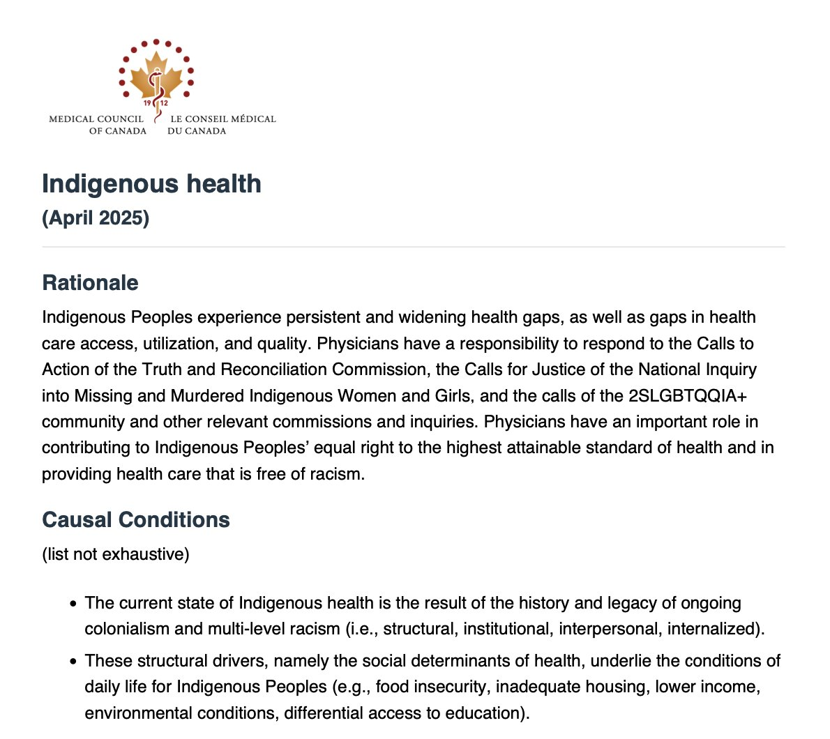

Slide 28
MCC Indigenous Health (April 2025)
Key Objective: Given an Indigenous patient, the candidate will demonstrate an awareness of the root causes of the inequitable health care and health outcomes experienced by Indigenous Peoples; understand the importance of and demonstrate anti-racist, culturally safe, trauma- and violence-informed care; articulate the inherent Indigenous and Treaty Rights (e.g., Medicine Chest Clause) relevant to the health of Indigenous Peoples; apply population health principles in understanding and advocating for Indigenous Peoples’ health at the individual, community, institutional (e.g., hospitals), and societal levels.
Notes:
https://mcc.ca/objectives/medical-expert/population-health-and-its-determinants/indigenous-health/

Slide 29
MCC Indigenous Health (April 2025)
Enabling Objectives (1-14):
1 | describe the connection between historical and current government policies and actions toward Indigenous Peoples (including but not limited to colonization, residential schools, treaties, and land claims) and the resulting intergenerational health outcomes;
2 | describe the relationship between the ongoing disruption of social, cultural and spiritual determinants of health due to colonization and the current state of Indigenous health (e.g., historical banning of traditional healing practices, loss of languages in the residential schools, loss of access to Traditional Territories);
3 | describe the various health services that are delivered to Indigenous Peoples and describe how multi-jurisdictional health care (federal, provincial, regional) can increase the risk of critical incidents, adverse events, medication errors, administrative barriers and/or interruptions in continuity of care;
4 | assess the role of racism in differential access to health care (e.g., access to primary and specialty care, medications, procedures and surgeries);
5 | define and demonstrate the following anti-racist health care culturally safe health care, cultural humility, trauma- and violence-informed care;
6 | describe the four key themes of the United Nations Declaration on the Rights of Indigenous Peoples and how they link to health outcomes (right to self-determination; right to cultural identity; right to free, prior and informed consent; and the right to be free from discrimination);
Notes:
https://mcc.ca/objectives/medical-expert/population-health-and-its-determinants/indigenous-health/

Slide 30
MCC Indigenous Health (April 2025)
Enabling Objectives (1-14):
7 | describe specifically the equal right to the highest attainable standard of health and the right to traditional medicines and health practices, as well as the right to access all social and health services without discrimination;
8 | demonstrate respectful discussion and collaboration regarding the use of traditional health practices
9 | recognize and facilitate the involvement of cultural resources that may be used to improve patients’ health (e.g., traditional activities, eating traditional foods, using medicines if they choose to do so, spiritual/cultural practices such as ceremonies);
10 | learn about Indigenous cultures to appreciate their traditions, worldviews, norms, values and beliefs;
11 | demonstrate awareness of the diversity of access to federal non-insured health services and benefits (NIHB) for First Nations (status and non-status), Métis, and Inuit;
12 | identify barriers to equitable health and health care for Indigenous Peoples and advocate for change at the systems level (e.g., organizational policy, healthy public policy);
13 | participate in the creation of safe clinical and learning environments through ensuring peer accountability;
14 | demonstrate an understanding of intersectionality as it relates to diverse Indigenous identities (e.g., 2SLGBTQQIA+, people who have disabilities, women).
Notes:
https://mcc.ca/objectives/medical-expert/population-health-and-its-determinants/indigenous-health/

