Slide 1
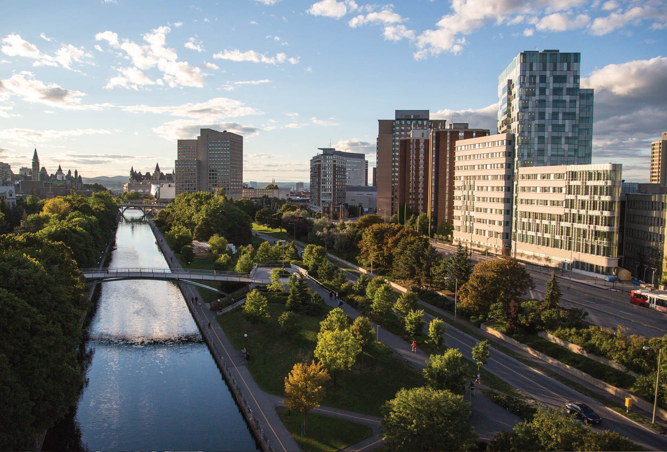

Advancing Indigenous Health Education in Undergraduate Medicine:
Curriculum Mapping and Gap Analysis in Response to Updated National Standards
Noah Bennell, Lyric Oblin-Moses, Hannah McKay, Mia Otten, Dr. Darlene Kitty, Dr. Alex Petiquan, Dr. Amy Nakajima, Dr. Laura Muldoon, Dr. Brad MacCosham, Luc Brisebois, Meghan Cornett, KJ Chen
Faculty of Medicine, University of Ottawa
Indigenous Medical Learners Association
April 17, 2026
Notes:
My name is Noah, and I’m a second-year medical student at the University of Ottawa. I am a member of the Northwest Territory Métis Nation.
I’m here to talk to you about the work we’ve done at the University of Ottawa to improve our Indigenous health curriculum.

Slide 2
Background: Indigenous Curriculum Working Group
The Gap: High-level strategic plans vs. actual classroom delivery.
The Mandate: Aligning UGME curriculum with national standards.
Our Tasks:
  Map: Audit existing curriculum content.
  Identify: Pinpoint critical educational gaps.
  Fill: Develop and implement new content to fill those gaps.
Notes:
While the University of Ottawa has a stated commitment to Reconciliation, we identified a significant gap in the Indigenous health content reaching our classrooms. The Indigenous Curriculum Working Group (ICWG) emerged from a convergence of factors: students’ frustration with this deficit and the University’s acknowledgment that more needed to be done.
Through a summer studentship, students took the lead on transforming our Indigenous health curriculum from the ground up. This allowed us to move the work beyond high-level "strategic goals" and into tangible, student-driven, and faculty-supported results.
The Working Group
We formed a collaborative team:
Indigenous students, residents, and physicians.
Non-Indigenous faculty and staff.
The Mandate
Our task was to move beyond theory and into tangible curriculum reform through a three-step process:
Map: Create a comprehensive audit of the existing uOttawa curriculum.
Identify: Pinpoint the specific gaps and absences within that map.
Implement: Develop and deploy new, high-impact content to fill those gaps.

Slide 3
Background: National Standards
Truth and Reconciliation (TRC) Call to Action #24
Medical Council of Canada (MCC) Indigenous Health Enabling Objectives
Committee on Accreditation of Canadian Medical Schools (CACMS) Element 7.6
Notes:
First, the TRC was our national inquiry into the legacy of Indigenous children’s forced assimilation in residential schools; their Call to Action #24 instructs medical schools to provide teachings on Indigenous history and rights.
Second, the MCC is our national qualifying body. By embedding 14 Indigenous health targets into their professional standards last year, they’ve made this knowledge a mandatory requirement for every physician seeking qualification in Canada.
Finally, CACMS is the national accrediting authority. Under Element 7.6, which was also recently updated in 2025, schools must demonstrate a robust and safe Indigenous health curriculum to maintain their accredited status.

Slide 4
Methods: Overarching Frameworks
Participatory Action Research Framework
Empowerment
Co-Creation
Lived Experience
Iterative Action
Two-Eyed Seeing
Engaged relevant Indigenous stakeholders.
Integrated perspectives from Indigenous students, residents, and physicians.
Focused on aligning Indigenous ways of knowing with institutional mandates and guidelines.
Notes:
[The "How we worked" part] To keep this simple, our work was guided by two main frameworks. The first is Participatory Action Research. Think of this as 'Research by the people, for the people'. Instead of an outside group studying us, Indigenous students took the lead, and the faculty supported us. We didn't just point out problems; we used our own lived experience as expert evidence to build the solutions. It was a constant cycle of checking our work, fixing it, and moving forward.
[The "The lens we used" part] The second idea is Two-Eyed Seeing. We didn’t want to choose between Indigenous knowledge and medical school standards; we wanted to use both. We used one eye to focus on Indigenous values, and the other eye to focus on the university's requirements.

Slide 5
Methods: Mapping
Learning Objectives (28)
Learning Events (10)
Format (7 lectures; 1 CBL; 1 SLM; 1 special event)
Examinable (8 non-examinable; 2 examinable)
Placement (all pre-clerkship)
CBL = Case-based learning module, SLM = self-learning module
Notes:
To begin our audit, we looked at the faculty’s foundation of the curriculum: the learning objectives.
We started with a systematic search. We compiled every learning objective tagged with terms like “Indigenous,” “First Nations,” “Métis,” or “Inuit.” We also included objectives related to “cultural safety.” Found a total of 28 learning objectives.
Learning Events: Once we had our list of objectives, we identified the specific learning events associated with them. We found 10 in total. For each event, we looked at three specific criteria:
Format: How was the lesson delivered? Was it a didactic lecture, a case-based learning module, an experiential activity, or something else?
Examinable: Was the content examinable?
Placement: Exactly where did this event fall within the four-year curriculum and in what units?

Slide 6
Methods: Mapping and Gap Analysis
For each item in each standard, we considered:
Volume: How many learning events covered the item?
Format: How was it taught? Was it delivered through multiple methods?
Examinable: Was the content formally examinable or not?
Longitudinal Integration: Was the content present in both the pre-clerkship and clerkship years?
Consensus agreement (e.g., through sharing circles and group discussions) to determine if there was a gap.
Notes:
With this data in hand, we mapped our findings back to items within the three national standards I mentioned earlier. For our gaps analysis, we considered:
Volume: How many learning events covered the item?
Second, Format: How was it taught? Was it delivered through multiple methods, such as a lecture and a case-based module?
Third, Examined: Was the content formally examined or not?
And fourth, Longitudinal Integration: Was the content present in both the pre-clerkship and clerkship years?
The identification of gaps was intentionally consensus-driven, which took the form of sharing circles and group discussions. We didn't just look at a checklist; we combined our data with our lived experience of the medical environment at uOttawa.

Slide 7
Results: The Three Frameworks
TRC Sub-item | Standard Definition | LOs (Applied Objectives) | Events (Count / Type / Status)
1. Health Issues | Understanding health disparities, demographics, and leading social/medical issues. | 64, 66, 2677, 2678, 2679, 2680, 5168, 5451, 11940, 12879, 12881, 12882, 14525, 14527 | 6 Events: 4 Lect (Non-Ex), 1 CBL (Non-Ex), 1 Lect (Ex)
2. Res. Schools | Identifying the history and intergenerational legacy of the residential school system. | 65, 14526 | 1 Event: 1 Lecture (Non-Ex)
3. UNDRIP | The UN Declaration on the Rights of Indigenous Peoples (self-determination and consent). | None | 0 Events
4. Treaties/Rights | Recognizing the legal/constitutional status of Treaties and Aboriginal rights. | None | 0 Events
5. Teachings | Appreciating Indigenous worldviews, traditional healing, and cultural values. | 50, 52, 79, 12885, 14527 | 3 Events: 2 Lectures (Non-Ex), 1 CBL (Non-Ex)
6. Intercultural | Skills-based training in cultural safety and effective communication. | 48, 5455, 11850, 11851, 12883, 14526 | 4 Events: 3 Lectures (Non-Ex), 1 SLM (Non-Ex)
7. Conflict Res. | Skills-based training in managing power dynamics and conflict in care. | None | 0 Events
8. Human Rights | Understanding domestic and international human rights legislation. | 14528 | 1 Event: 1 Lecture (Non-Ex)
9. Anti-Racism | Skills-based training to identify and combat systemic racism in clinical settings. | 12884, 14526 | 2 Events: 2 Lectures (Non-Ex)
Notes:
In total, we identified gaps in all 9 of the TRC items, with three being complete gaps with no content coverage.

Slide 8
Results: The Three Frameworks
MCC Objective | Objective Focus | Mapped LOs | Events (Count / Type / Status)
1. History | Historical/current policies (Colonization, Res Schools) and outcomes. | 65, 14526 | 2 Events: 2 Lect (Non-Ex)
2. SDOH | Determinants of health (housing, poverty) and impacts of colonization. | 64, 65, 66, 5168, 11940 | 4 Events: 2 Lect (Non-Ex), 1 CBL (Non-Ex), 1 Lect (Ex)
3. Delivery | Federal/Provincial service delivery and jurisdictional barriers to care. | 2677, 14525, 14528 | 2 Events: 2 Lect (Non-Ex)
4. Racism | Assessing the role of racism in differential access to healthcare services. | 12884 | 1 Event: 1 Lect (Non-Ex)
5. Cultural Safety | Applying humility, safety, and trauma-informed care principles. | 48, 11850, 11851, 12883, 14526 | 4 Events: 3 Lect (Non-Ex), 1 SLM (Non-Ex)
6. UNDRIP | UN Declaration themes (Self-determination, Identity, Consent). | None | 0 Events
7. Health Rights | Right to highest standard of health and traditional medicines. | 52, 12885, 14528 | 2 Events: 2 Lect (Non-Ex)
8. Collaboration | Respectful collaboration regarding use of traditional practices. | 5455, 12885 | 2 Events: 1 Lect (Non-Ex), 1 CBL (Non-Ex)
9. Resources | Involvement of cultural resources (food, ceremony, medicines). | 79, 2678 | 2 Events: 2 Lect (Non-Ex)
10. Culture | Appreciating worldviews, traditions, norms, values, and beliefs. | 50, 14527 | 2 Events: 2 Lect (Non-Ex)
11. NIHB | Diversity of access to federal Non-Insured Health Benefits. | None | 0 Events
12. Advocacy | Identifying barriers and advocating for systems-level change. | 4, 2679, 2680, 5451 | 2 Events: 1 Lect (Non-Ex), 1 CBL (Non-Ex)
13. Accountability | Safe clinical/learning environments and peer accountability. | None | 0 Events
14. Intersectionality | Diverse identities (2SLGBTQQIA+, disabilities, women). | None | 0 Events
Notes:
We identified gaps in all 14 MCC objectives, with 4 being complete gaps.

Slide 9
Results: The Three Frameworks
CACMS Element | Accreditation Focus | Learning Events (Type / Status)
7.6-1 A | Opportunities: Providing required experiences on diverse Indigenous needs. | 11 Total Events: 8 Lect (Non-Ex), 2 CBL (Non-Ex), 1 SLM (Non-Ex), 1 Lect (Ex)
7.6-2 A | Rights: Preparing students to identify legal/protected rights under legislation. | 1 Event: 1 Lecture (Non-Ex)
7.6-2 B | Skills/TIC: Developing behaviors for culturally safe and trauma-informed care. | 4 Events: 3 Lectures (Non-Ex), 1 SLM (Non-Ex)
7.6-2 C | Systems of Harm: Identifying how systems perpetuate racism, disparities, and harm. | 2 Events: 2 Lectures (Non-Ex)
Notes:
We identified gaps in all relevant CACMS 7.6 sub-elements.

Slide 10
Results: National Standards
In total, we identified gaps in all 9 of our TRC items, with three being complete gaps with no content coverage.
We identified gaps in all 14 MCC objectives, with 4 being complete gaps.
We identified gaps in all 4 relevant CACMS 7.6 sub-elements.

Slide 11
Results: Example from TRC Call to Action #24
We call upon medical and nursing schools in Canada to require all students to take a course dealing with Aboriginal health issues, including the history and legacy of residential schools, the United Nations Declaration on the Rights of Indigenous Peoples, Treaties and Aboriginal rights, and Indigenous teachings and practices. This will require skills-based training in intercultural competency, conflict resolution, human rights, and anti-racism.
Notes:
I will present an example using TRC Call to Action #24, which I briefly discussed earlier, and encourage you to look up on your own if you are unfamiliar.
TRC:
24. We call upon medical and nursing schools in Canada to require all students to take a course dealing with Aboriginal health issues, including the history and legacy of residential schools, the United Nations Declaration on the Rights of Indigenous Peoples, Treaties and Aboriginal rights, and Indigenous teachings and practices. This will require skills-based training in intercultural competency, conflict resolution, human rights, and anti-racism

Slide 12
Results: Example from TRC Call to Action #24
Item | Definition | Learning Objectives | Events | Gap Analysis
1. Indigenous Health Issues | Understanding health disparities, demographics, and leading social/medical issues. | 64, 66, 2677, 2678, 2679, 2680, 5168, 5451, 11940, 12879, 12881, 12882, 14525, 14527 | 6 Events: 4 Lect (Non-Ex), 1 CBL (Non-Ex), 1 Lect (Ex) (All Pre-Clerkship) | Gap; Content present; multiple formats, although largely lecture-based; partially evaluated; no clerkship integration (lies mostly within the Introductory unit)
CBL = Case-based learning module, SLM = self-learning module
Notes:
Content present, although in the grand-scheme of a four-year curriculum, minimal. Delivered in multiple formats, although primarily lecture-based. Only one of the events was evaluated. And no clerkship integration, in fact, most during introductory unit.

Slide 13
Results: Overarching Themes
Front-Loaded & Sparse Integration: Content is heavily concentrated in early introductory units.
Pedagogical Mismatch: An over-reliance on didactic lectures.
The Accountability Gap: Largely non-examined.
Knowledge Gaps: Significant omissions regarding distinct group histories and rights-based policies.
Notes:
From all these items, we did identify some overarching themes. We found that the curriculum was essentially 'front-loaded'—you got four Indigenous health activities in week one, and then the other six were only sparsely integrated throughout the rest of pre-clerkship, with nothing in clerkship, making it difficult to retain the information and apply it long-term.
This was compounded by a pedagogical mismatch; we were using lectures to teach topics that really require experiential engagement. Out of the 10 learning events, only 3 were not didactic lectures.
Perhaps most importantly, we found an accountability gap. Only 2 of the 10 events were examinable. Because the content wasn't examinable (due to most of it being in the Introductory week), it didn't carry the same 'weight' as other subjects.
We also realized we were missing sufficient content in certain areas of Indigenous health. The students felt there could be more of a focus on Indigenous history, as well as the 'nitty-gritty'—the actual policies like UNDRIP or NIHB that we will encounter in practice every day.

Slide 14
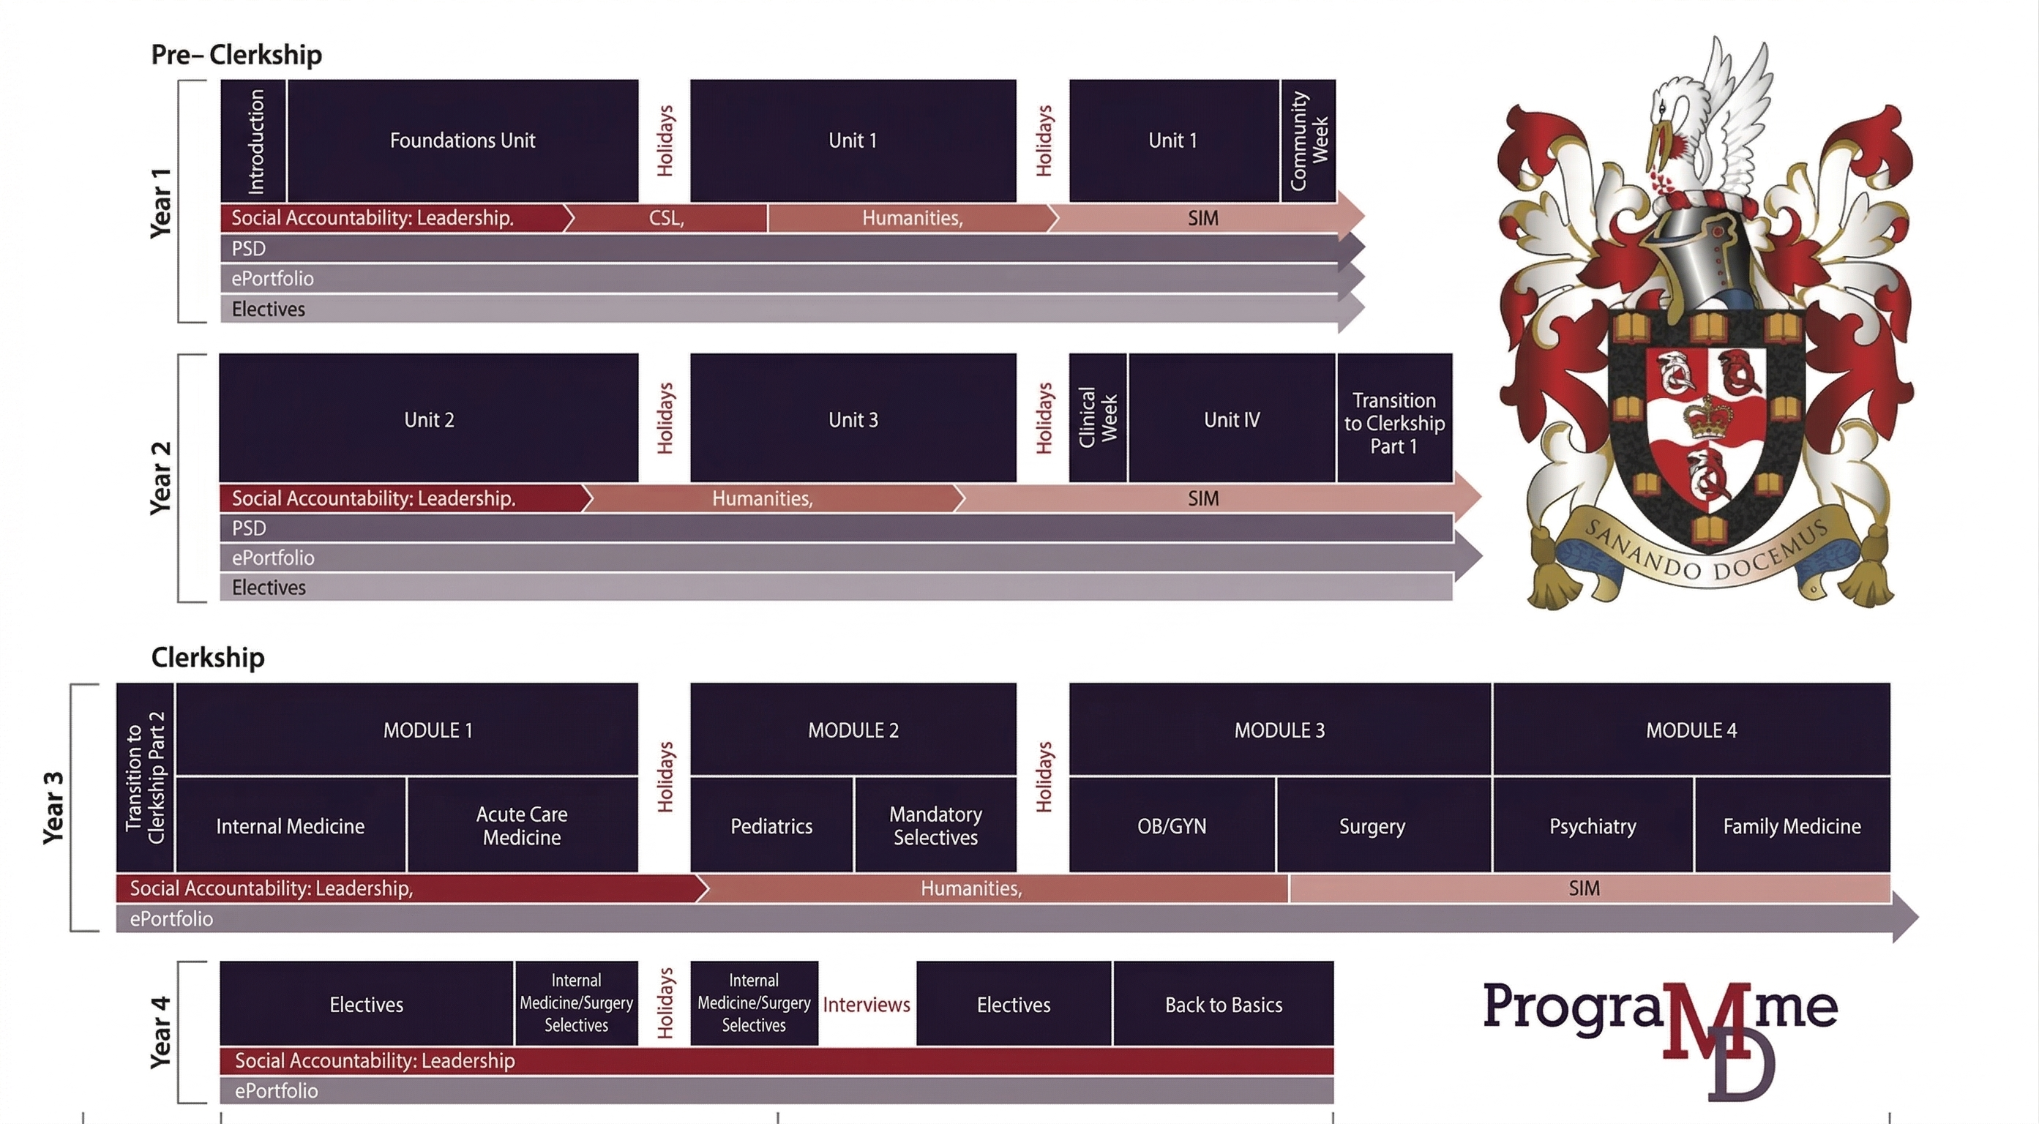
Notes:
Green = Examinable, Red = Non-examinable
Circle = Lecture, Square = CBL, Triangle = Practical, Diamond = Other

Slide 15
Results: Recommendations
Longitudinal Integration: Enhancing the clerkship curriculum.
Activity Diversity: Shifting from didactic lectures to experiential and skills-based training.
Formal Assessment: Implementing assessable content to ensure student accountability.
Content Specificity: Addressing technical gaps (e.g., Non-Insured Health Benefits program) previously absent from the curriculum.
Notes:
In line with these findings…
Our audit pointed to four key priorities:
Longitudinal Integration: We need to enhance the curriculum in clerkship years.
Activity Diversity: We needed to shift our focus from didactic lectures toward experiential and skills-based training.
Assessment: We needed to create formally assessable content to ensure student accountability.
Content Specificity: we needed to address technical areas of Indigenous health—such as the NIHB system—that were previously absent.

Slide 16
Results: Implementation
The Blanket Exercise, which is now a mandatory experiential activity for all first-year students.
Three pre-clerkship case-based modules that are formally assessable.
Two clerkship case-based activities, which represent our first steps toward longitudinal integration in the clinical years.
Note: Students were not involved in developing exam questions or creating assessments for the above activities.
Notes:
While much of this presentation has been quite critical, I am glad to report that this process has already led to significant structural changes. Since we completed the analysis in August 2025, our working group has contributed to the development and implementation of six new or adapted learning events.
These include:
The Blanket Exercise, which is now a mandatory experiential activity for all first-year students.
Three new pre-clerkship case-based modules that are formally assessable.
Two new clerkship case-based activities, which represent our first steps toward longitudinal integration in the clinical years.
Also wanted to note that a lot of the introductory week content was made examinable.
This work is ongoing. Our future plans include a full revision of our learning objectives to ensure they use skills-based verbs, the development of Indigenous-focused OSCE stations for clinical assessment, and improving student access to learning opportunities directly within Indigenous communities.

Slide 17
Notes:
Green = Examinable, Red = Non-examinable
Circle = Lecture, Square = CBL, Triangle = Practical, Diamond = Other

Slide 18
Discussion
Successes
Student-Led
Faculty Representation
Two-Eyed Seeing
Considerations
Building Institutional Readiness
Logistical Challenges Within Medical Curricula
The Future
Avoiding “checklist thinking”
An evolving curriculum
Notes:
Successes The success of this initiative is rooted in it being student-led. As the recipients of this education, we have the most direct insight into where it falls short.
-Faculty allies were also essential for moving from ideas to action. Our working group included Dr. Chen, the Assistant Dean of Curriculum, Dr. Nakajima, the Pre-clerkship Co-Director, Dr. Muldoon, the Society and Medicine Pillar Director, Dr. MacCosham, the Senior Manager of Accreditation and Evaluation, as well as two Indigenous mentors and advocates in Dr.’s Petiquan and Kitty.
-Our Two-Eyed Seeing approach also allowed us to bring our perspectives as Indigenous learners, residents, and physicians to the table to reshape the University's existing frameworks.
Considerations One of the most important takeaways from this process was the time required for Institutional Readiness. We recognized early on that shifting a long-standing academic culture toward Indigenous ways of knowing doesn't happen overnight. It required a lot of intentional relationship building to align our vision with the faculty's existing standards. Logistically, medical curricula are already over-saturated and time constrained. Faced some difficulties with implementation. To overcome this, we didn't just ask for more time; we adapted pre-existing content to include Indigenous perspectives.
The Path Forward Crucially, institutions must avoid "checklist thinking." Reconciliation isn’t about ticking a box; it requires ongoing critical thinking and active conversation to ensure education is truly sufficient. This must be a living project—as standards, requirements, and community insights change, the curriculum must evolve alongside them.
Significance Ultimately, the value of this work goes beyond our own institution. We have developed a replicable framework for curriculum mapping and gap analysis that can be applied to any medical program—and even adapted to address health inequities for other populations.

Slide 19
References
Committee on Accreditation of Canadian Medical Schools. (2025, February). CACMS standards and elements: Standards for accreditation of medical education programs leading to the M.D. degree. https://cacms-cafmc.ca/wp-content/uploads/2025/02/CACMS-Standards-and-Elements-AY-2026-2027_FINAL.pdf
Google. (2026). Gemini (Version 3 Flash) [Large language model]. https://gemini.google.com (Used for content organization)
Medical Council of Canada. (2025). Indigenous health. https://mcc.ca/objectives/medical-expert/population-health-and-its-determinants/indigenous-health/
Truth and Reconciliation Commission of Canada. (2015). Truth and Reconciliation Commission of Canada: Calls to action. https://www2.gov.bc.ca/assets/gov/british-columbians-our-governments/indigenous-people/aboriginal-peoples-documents/calls_to_action_english2.pdf

Slide 20
Miigwetch, Thank You, Merci
Notes:
To conclude, I hope that those of you involved in your own school’s curriculum take notice of this process. I encourage you to remain open to new ideas and, most importantly, to support and collaborate with your students in leading these changes.
Thank you.

